Slide 1
Travel Package Purchase Prediction

Slide 2
Contents
Background & Problem Statement
Data Dictionary
Exploratory Data Analysis Highlights
Model Performance Summary
Recommendations

Slide 3
Background & Problem Statement

Slide 4
There is a need to expand the customer base, and hence newly introduced packages are introduced.

Slide 5
However, the marketing cost was quite high as customers were contacted at random without looking at the available information.

Slide 6
We require a model that can predict potential customers who have a higher probability of purchasing the newly introduced packages.
Here, several models from ensemble techniques will be used.

Slide 7
Data Dictionary
The data contains information about 4888 customers and their characteristics. Data pre-processing was done, which includes outlier treatment, conversion of ‘Fe Male’ to ‘Female’, and imputation of missing data.

Slide 8
Variable | Description
CustomerID | Unique customer ID
ProdTaken | Whether the customer has purchased a package or not (0: No, 1: Yes)
Age | Age of customer
TypeofContact | How customer was contacted (company invited or self inquiry)
CityTier | Value depends on the development of a city, population, facilities, and living standards (1, 2, or 3)
Occupation | Occupation of customer
Gender | Gender of customer
NumberOfPersonVisiting | Total number of persons planning to take the trip with the customer
PreferredPropertyStar | Preferred hotel property rating by customer
MaritalStatus | Marital status of customer
NumberOfTrips | Average number of trips in a year by customer
Passport | Whether customer has a passport or not (0: No, 1: Yes)
OwnCar | Whether customer own a car or not (0: No, 1: Yes)
NumberOfChildrenVisiting | Total number of children with age less than 5 planning to take the trip with the customer
Designation | Designation of the customer in the current organization
MonthlyIncome | Gross monthly income of the customer
PitchSatisfactionScore | Sales pitch satisfaction score
ProductPitched | Product pitched by the salesperson
NumberOfFollowups | Total number of follow-ups has been done by the salesperson after the sales pitch
DurationOfPitch | Duration of the pitch by a salesperson to the customer

Slide 9
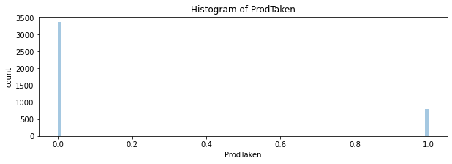
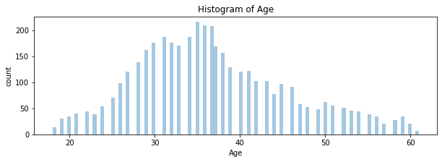
Exploratory Data Analysis Highlights
There are more customers who did not take the package
Age is normally distributed

Slide 10
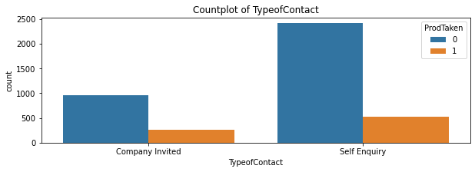
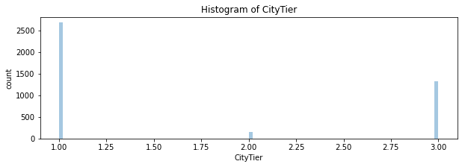
Exploratory Data Analysis Highlights
There are more people that made a self enquiry for the product.
Most of the people are from CityTier of 1

Slide 11
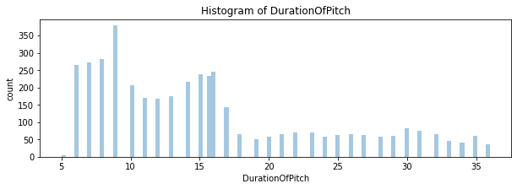
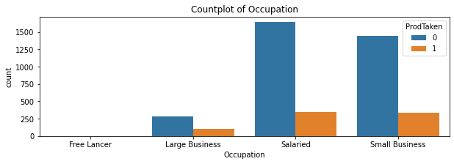
Exploratory Data Analysis Highlights
DurationOfPitch is right skewed
Most of the customers are salaried or have a small business

Slide 12
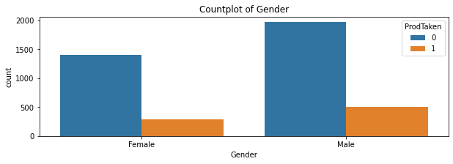
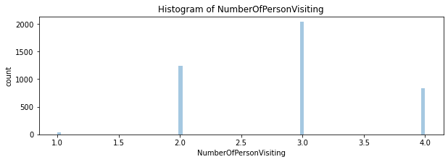
Exploratory Data Analysis Highlights
Most of the customers are male
On average, around 3 people join the trip with the customer

Slide 13
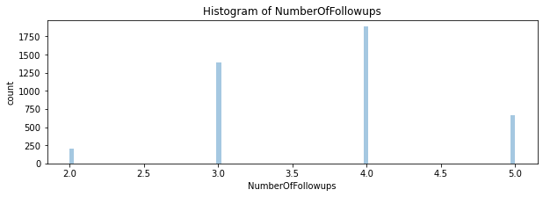
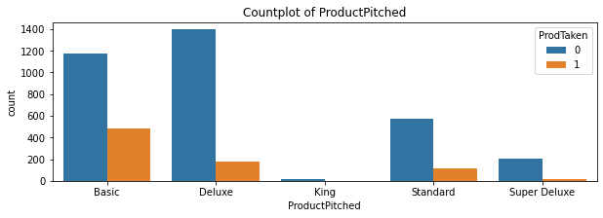
Exploratory Data Analysis Highlights
The number of followups are around 3-4 generally
There are more product pitches of Basic and Deluxe

Slide 14
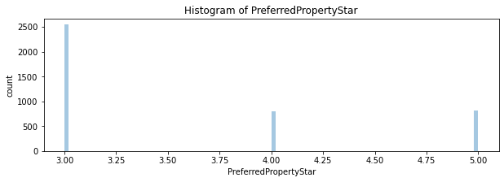
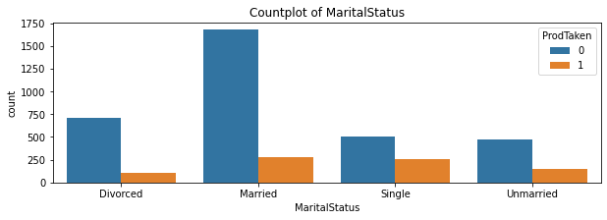
Exploratory Data Analysis Highlights
Most of the preferred property star is 3
Most of the customers are married. For product takers, most are either married or single.

Slide 15
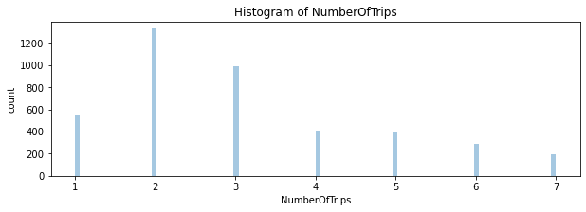
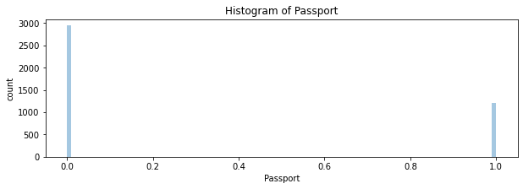
Exploratory Data Analysis Highlights
Most of the number of trips per year of customer is 2.
Most of the customers do not have a passport.

Slide 16
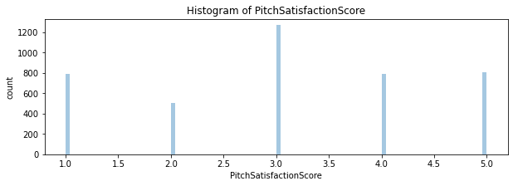
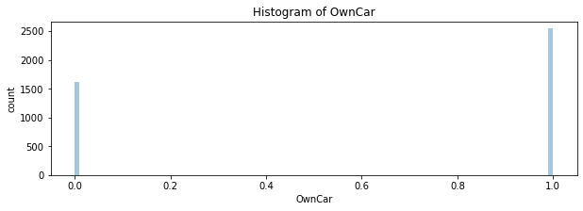
Exploratory Data Analysis Highlights
It seems that the pitch satisfaction score is at an average of 3
Many of the customers own a car

Slide 17
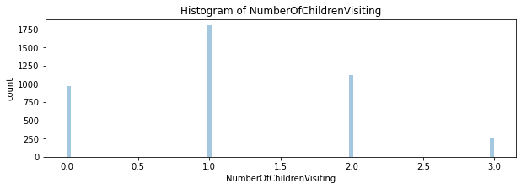
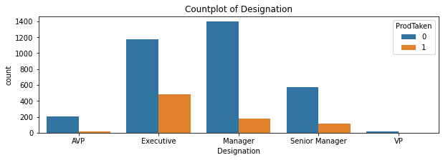
Exploratory Data Analysis Highlights
Generally, the number of children that went with customer is 1
The product is pitched mostly to executives and managers. However, there are more executives who ended up taking the product/package.

Slide 18
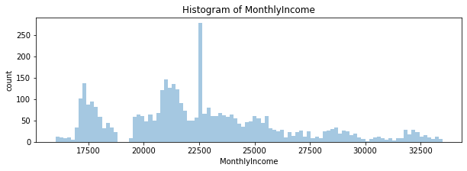
Exploratory Data Analysis Highlights
Many of the customers have a monthly income of around 17500 to 25000.

Slide 19
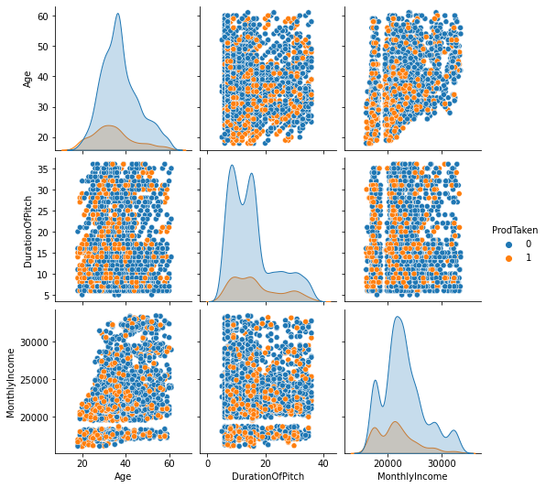
Exploratory Data Analysis Pairplot

Slide 20
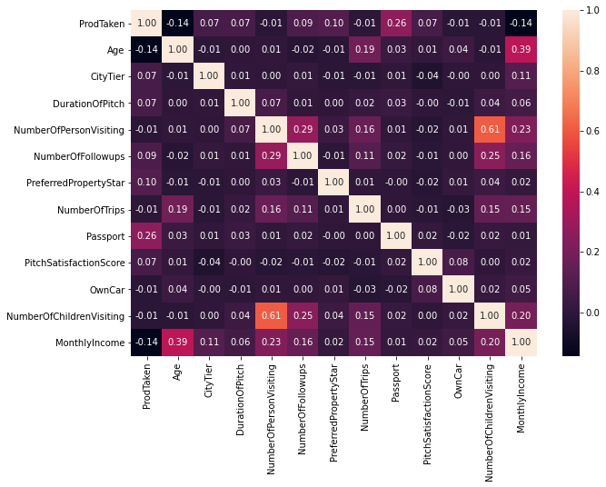
Exploratory Data Analysis Heatmap
There are no notable correlation between the variables.

Slide 21
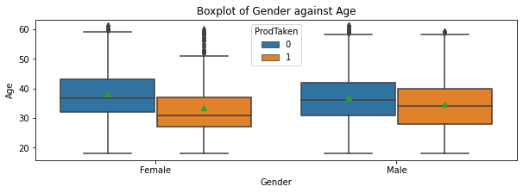
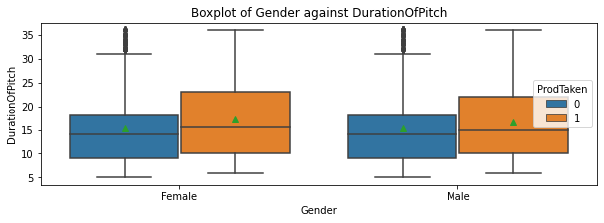
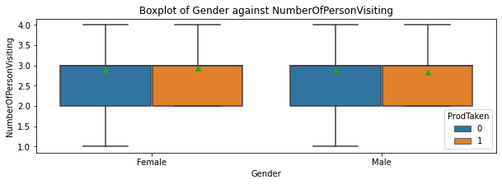
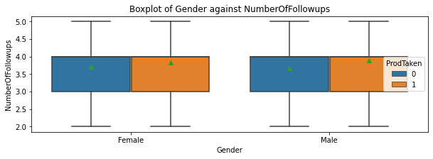
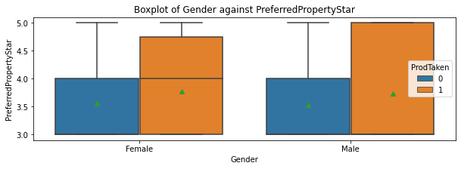
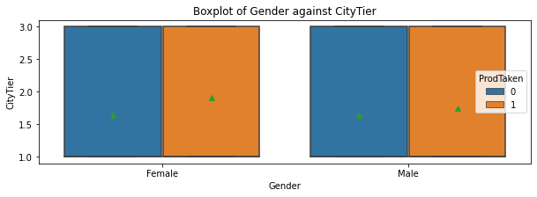
Characteristics of Product Takers

Slide 22
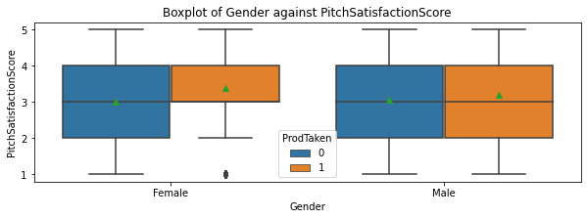
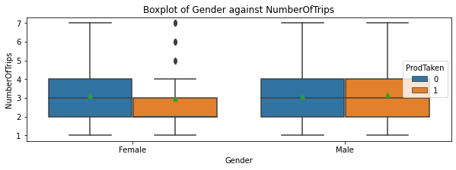
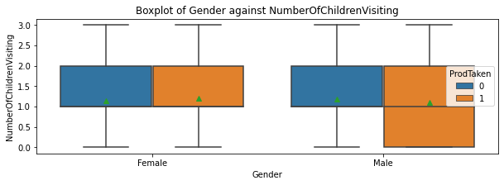
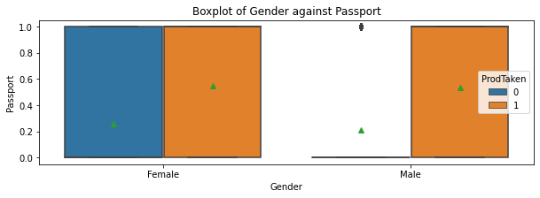
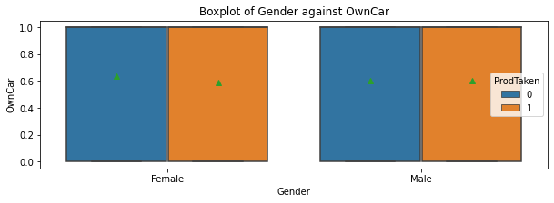
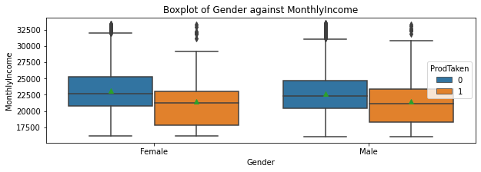
Characteristics of Product Takers

Slide 23
Characteristics of Product Takers
Have lower age.
Have longer duration of pitch.
Have passports.
Have somewhat higher preferred property star.
Have somewhat higher number of followups.
Have a higher average of city tier.
Have higher pitch satisfaction score.
Have less monthly income.

Slide 24
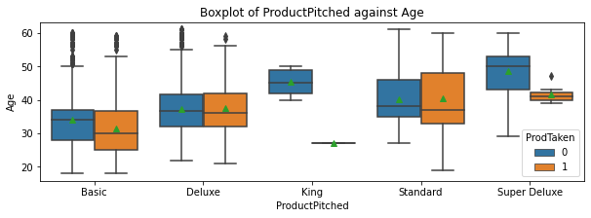
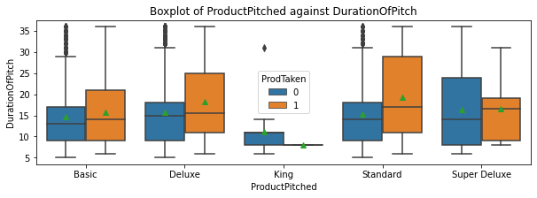
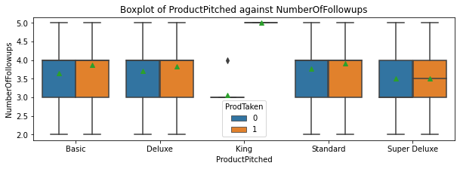
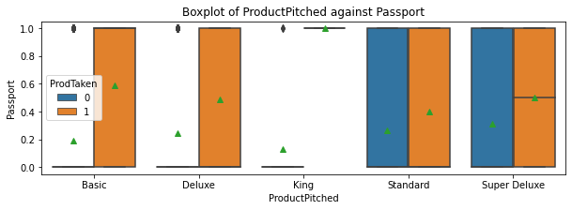
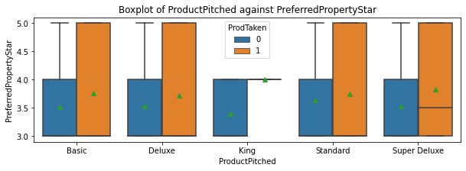
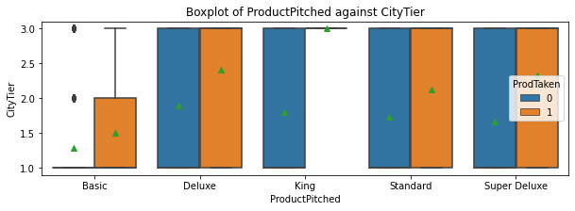
Characteristics of Customer Over Different Products

Slide 25
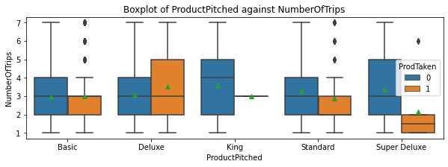
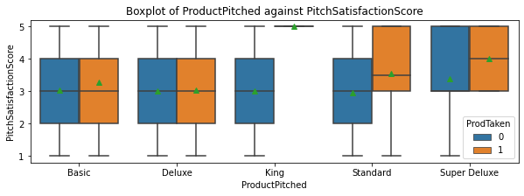
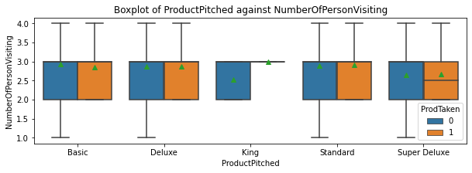
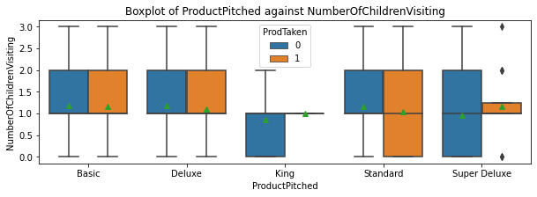
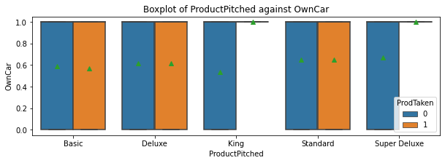
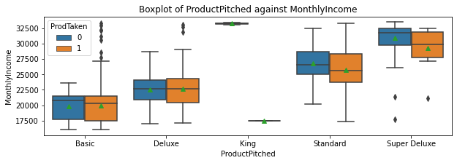
Characteristics of Customer Over Different Products

Slide 26
Characteristic of Basic Product Customers
a. Taken by younger people - aged around 25 to 35
b. City tier around 1-2
c. Duration of pitch around 10-20 mins
d. NumberOfPersonVisiting is around 2-3 people
e. Followed up around 3-4 times, with 4 on average
f. Average property star is around 3.8
g. Average number of trips per year is 3
h. Around 60% have passport
i. Pitch satisfaction score average is around 3.3 on average
j. Slightly less than 60% own a car
k. NumberOfChildrenVisiting is 1 on average
l. Have average salary of around 20000

Slide 27
Characteristic of Deluxe Product Customers
a. Taken by people aged around 30 to 40
b. City tier mostly are 2 or 3
c. Average duration of pitch is around 18 mins
d. NumberOfPersonVisiting is 2-3 people
e. Followed up around 3-4 times, with 4 on average
f. Average property star is around 3.8
g. Average number of trips per year is 3.5
h. Around 50% have passport
i. Pitch satisfaction score is around 3 on average
j. Around 60% own a car
k. NumberOfChildrenVisiting is 1 on average
l. Have average salary of around 22500

Slide 28
Characteristic of King Product Customers
a. The product is marketed to those with age above 40, but none took the product. The buyers are young adults slightly below 30 years old.
b. All buyers are of city tier 3.
c. Duration of pitch is slightly below 10 minutes for buyers.
d. All buyers have 3 NumberOfPersonVisiting
e. All buyers are followed up 5 times. Nonbuyers are not followed up up to 5 times.
f. All buyers have preferred property star of 4
g. All buyers have number of trips per year of 3
h. All buyers have passport.
i. All buyers have pitch satisfaction score of 5.
j. All buyers have a car.
k. All buyers have NumberOfChildrenVisiting of 1.
l. The product is marketed to those with high monthly salary (more than 32500), but buyers have low monthly salary of around 17500.

Slide 29
Characteristic of Standard Product Customers
a. Taken by people of age around 35 to 45 years old
b. City tier of 2 on average
c. Duration of pitch of 20 mins on average
d. NumberOfPersonVisiting is 2-3 people
e. Followed up around 3-4 times, with 4 on average
f. Average property star is around 3.8
g. Average number of trips per year of 3
h. Around 40% have passport
i. Have an average of 3.5 of pitch satisfaction score
j. More than 60% have a car
k. NumberOfChildrenVisiting is 1 on average
l. Have monthly income of around 25000 to 27500

Slide 30
Characteristic of Super Deluxe Product Customers
a. Product is marketed to those with age around 45-55 years old, but buyers are around 40-45 years of age.
b. City tier of 2.25 on average.
c. Average duration of pitch is around 18 mins
d. The average NumberOfPersonVisiting is around 2.75
e. Average number of followups is 3.5
f. Average number of preferred property star is around 3.9
g. The average number of trips per year is 2
h. Around 55% have passport
i. The average pitch satisfaction score is 4
j. All buyers have a car
k. NumberOfChildrenVisiting is 1 on average
l. Have monthly income of around 27500 to 32500

Slide 31
Model Performance Summary
Both bagging and boosting methods are applied, with 70% of data used as training data and 30% of data used as testing data
Precision is used as the main indicator of the models, as we want to avoid having false positives which could incur money loss due to waste of marketing efforts.
We also want to maintain a good number of correct predictions.
We also want to use F1 score as another indicator of the model.

Slide 32
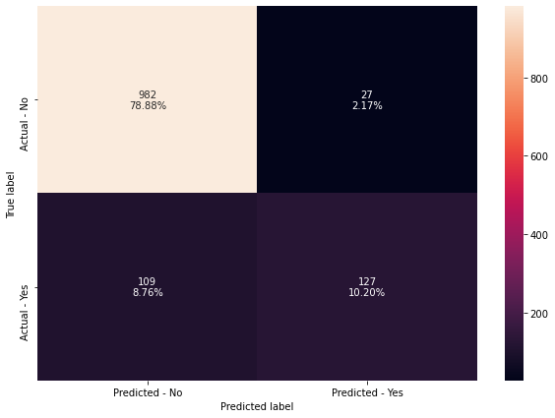
Bagging Classifier (Decision Tree as base estimator by default)

Slide 33

Random Forest

Slide 34

Tuned Bagging Classifier

Slide 35
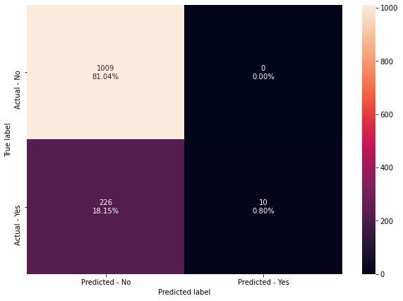
Bagging Classifier with Logistic Regression as base estimator

Slide 36
Tuned Bagging Classifier with Logistic Regression as base estimator

Slide 37
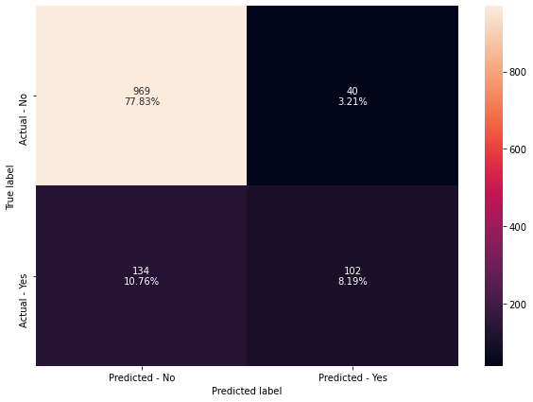
Tuned Random Forest Classifier

Slide 38
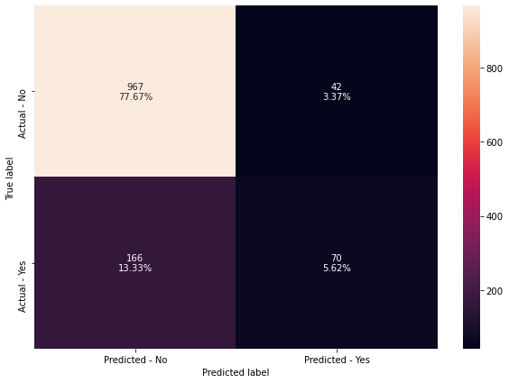
AdaBoost Classifier

Slide 39

Tuned AdaBoost Classifier

Slide 40

Gradient Boosting

Slide 41
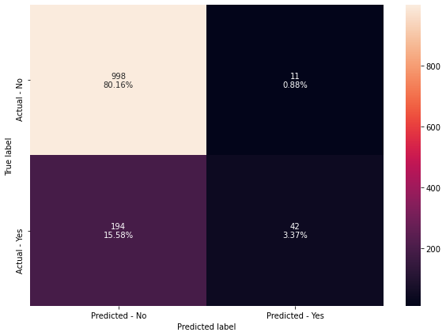
Tuned Gradient Boosting

Slide 42

Tuned Gradient Boosting with init = Adaboost

Slide 43

XGBoost

Slide 44

Tuned XGBoost

Slide 45
Metrics of the models
 | Model | Train_Accuracy | Test_Accuracy | Train_Recall | Test_Recall | Train_Precision | Test_Precision | Train_F1 | Test_F1
0 | Bagging Classifier with default parameters | 0.99 | 0.89 | 0.96 | 0.54 | 1.00 | 0.82 | 0.98 | 0.65
1 | Random Forest with default parameters | 1.00 | 0.89 | 1.00 | 0.47 | 1.00 | 0.88 | 1.00 | 0.62
2 | Tuned Bagging Classifier | 1.00 | 0.89 | 1.00 | 0.50 | 1.00 | 0.87 | 1.00 | 0.63
3 | Bagging classifier with base_estimator=LR | 0.82 | 0.82 | 0.07 | 0.04 | 1.00 | 1.00 | 0.12 | 0.08
4 | Tuned Bagging classifier with base_estimator=LR | 1.00 | 0.89 | 1.00 | 0.50 | 1.00 | 0.87 | 1.00 | 0.63
5 | Tuned Random Forest Classifier | 0.97 | 0.86 | 0.88 | 0.43 | 0.95 | 0.72 | 0.92 | 0.54
6 | AdaBoost with default parameters | 0.85 | 0.83 | 0.34 | 0.30 | 0.73 | 0.62 | 0.47 | 0.40
7 | AdaBoost Tuned | 0.82 | 0.82 | 0.05 | 0.04 | 0.94 | 0.82 | 0.10 | 0.07
8 | Gradient Boosting with default parameters | 0.89 | 0.84 | 0.50 | 0.31 | 0.89 | 0.67 | 0.64 | 0.43
9 | Gradient Boosting Tuned | 0.85 | 0.84 | 0.25 | 0.18 | 0.92 | 0.79 | 0.39 | 0.29
10 | Gradient Boosting with init=AdaBoost Tuned | 0.85 | 0.83 | 0.23 | 0.17 | 0.92 | 0.81 | 0.37 | 0.27
11 | XGBoost with default parameters | 1.00 | 0.90 | 1.00 | 0.58 | 1.00 | 0.82 | 1.00 | 0.68
12 | XGBoost Tuned | 0.84 | 0.83 | 0.17 | 0.11 | 0.95 | 0.90 | 0.28 | 0.20

Slide 46
Model Performance Summary
Based on the metrics of all the models above combined, the model with the best test precision is bagging classifier with logistic regression as base estimator, followed by tuned XGBoost.
However, the F1 score for the two models are very low, shown by a very low number in true positives. Adding the F1 score and number of true positives as consideration, a good model for the prediction would be either tuned bagging classifier, tuned bagging classifier with logistic regression as base estimator, and XGBoost with default parameters.

Slide 47
Most Important Predictors
1st : Executive
2nd : Passport
3rd : Single
4th : Large Business

Slide 48
Recommendations to Marketing Team (ordered by priority)
To stop marketing the product King to those aged above 40, as there is 0% success rate, and it would be a waste on resources
To target more people with executive as designation
To target more people with passports
To target more single people
To target more people who works in a/owns a large business
To focus more on selling the product Basic, Deluxe and Standard as they are much more frequently bought by customers
To target customers on higher city rating

